Slide 1
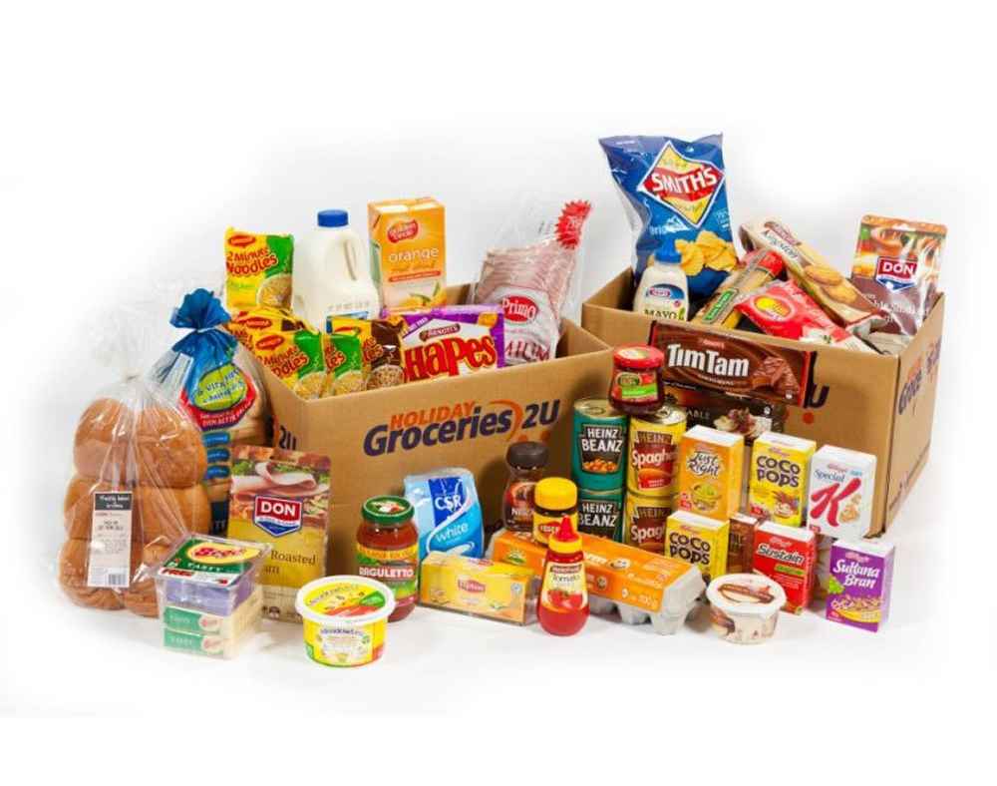
Say No to Unhealthy Food
A Path to Better Food India

Slide 2
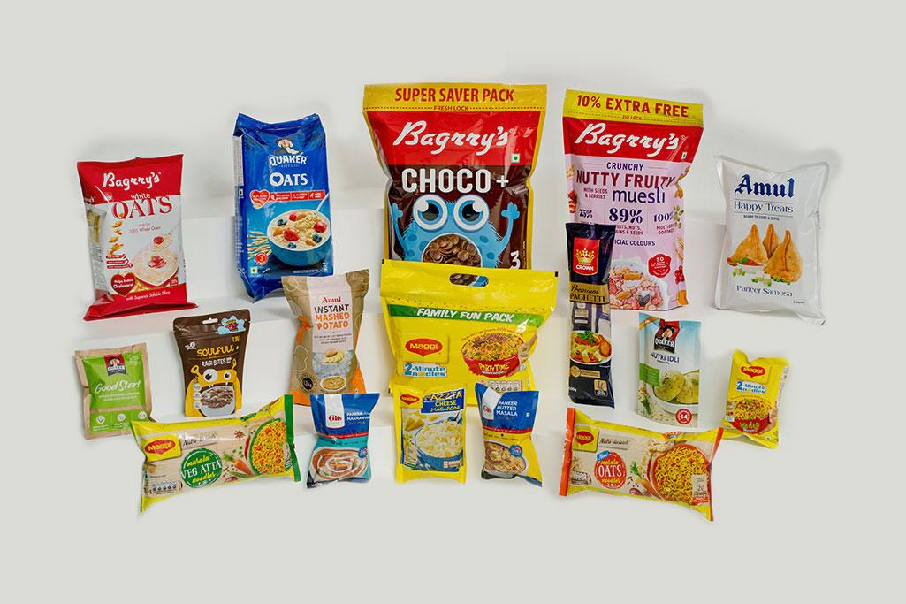
Introduction
India's packaged food industry is rapidly growing, but many products contain misleading labels and harmful additives.
Consumers unknowingly consume artificial ingredients and chemicals, leading to serious health risks.
Objective: To analyze false claims, unauthorized synthetic additives, and misleading packaging in India’s food industry.

Slide 3



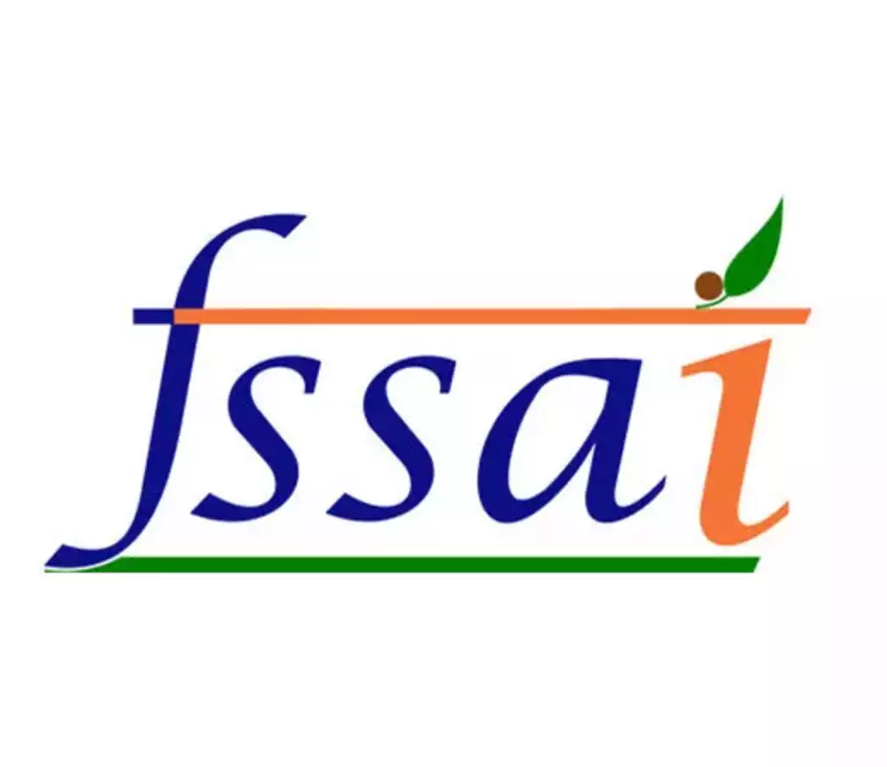
Global vs. Indian Regulations
EU & Japan: Strict regulations ban harmful additives, ensuring safe and transparent food labeling.
U.S.: Strong recall systems and rigorous testing help maintain food safety standards.
India: Weak enforcement allows unsafe additives and misleading labels. Strengthening FSSAI rules and public awareness is crucial.

Slide 4

What Our Case Studies Shows
Juices & Soft Drinks: Contain high sugar, artificial flavors, and sweeteners but are falsely marketed as "natural" and "healthy.”
Instant Noodles & Spices: Some brands have been found using banned additives, excess preservatives, and even harmful chemicals. Counterfeit & Misleading Branding:
Fake brands imitate trusted products with false trademarks and misleading labels.
False Test Claims: Some packaged foods falsely claim to be "lab-tested" or "100% pure," despite containing unsafe levels of contaminants.

Slide 5

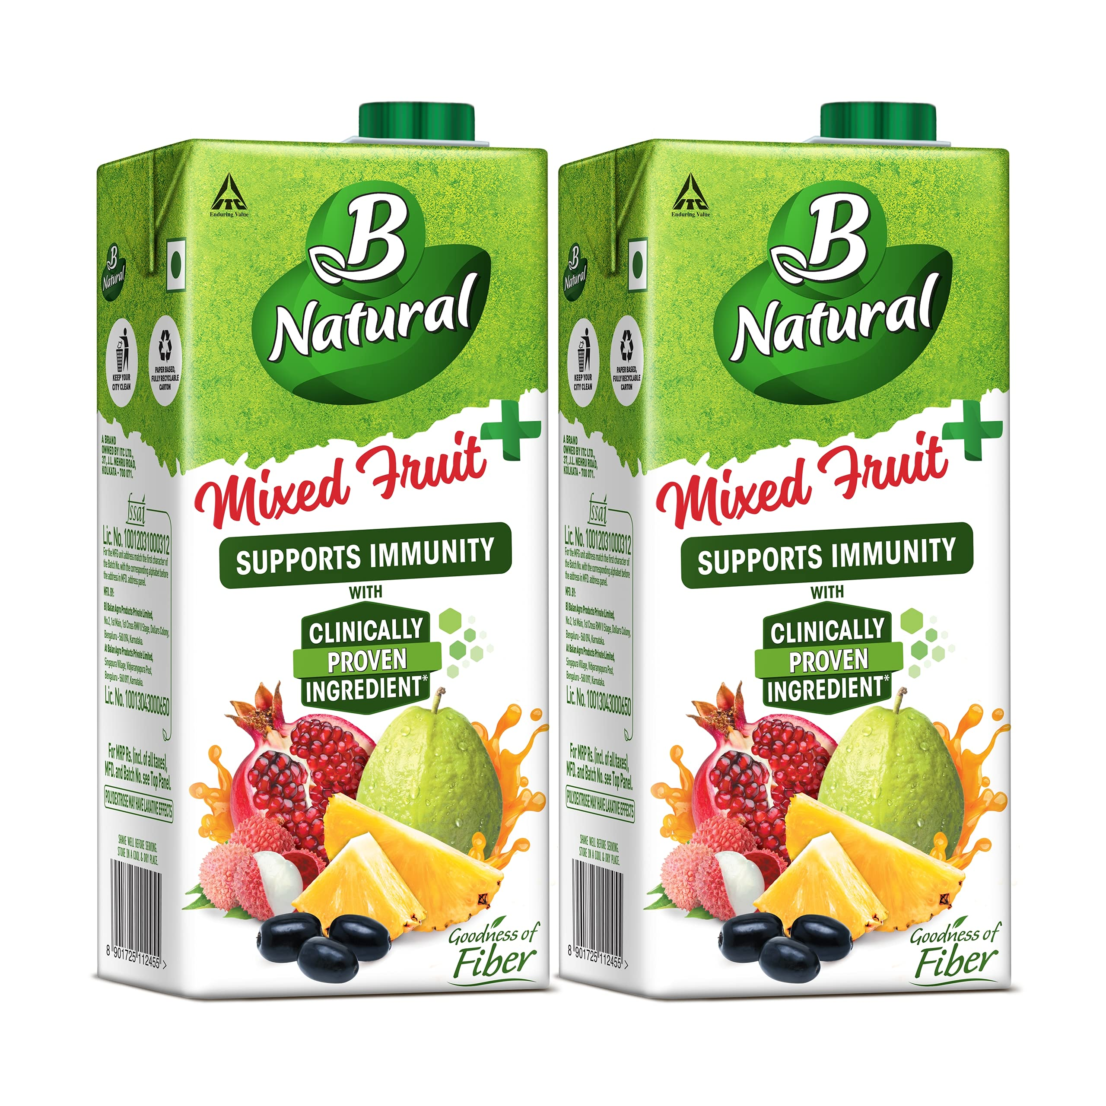
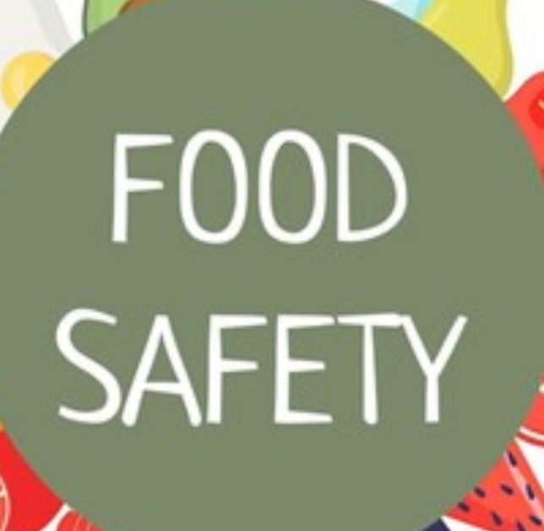
False Claims & Misleading Labels
Many brands claim "natural" "pure," or "organic" while using artificial ingredients.
Mis leading trademarks & counterfeit brands mislead consumers.
Food safety tests are often manipulated to pass low-quality products.

Slide 6

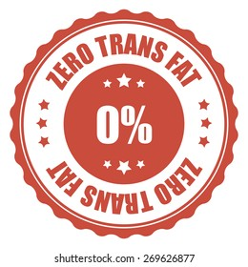
The Hidden Dangers in Packaged Foods in India
Artificial Sweeteners → Used as sugar substitutes; may have health risks.
Trans Fats → Found in fried & processed foods.
Artificial Colors & Preservatives → Enhance appearance & shelf life.
High Fructose Corn Syrup (HFCS) → Increases obesity risk; commonly found in soft drinks & snacks.
MSG (Monosodium Glutamate) → Used in instant foods.
Excess Sodium & Hidden Sugars → Found in processed foods.

Slide 7

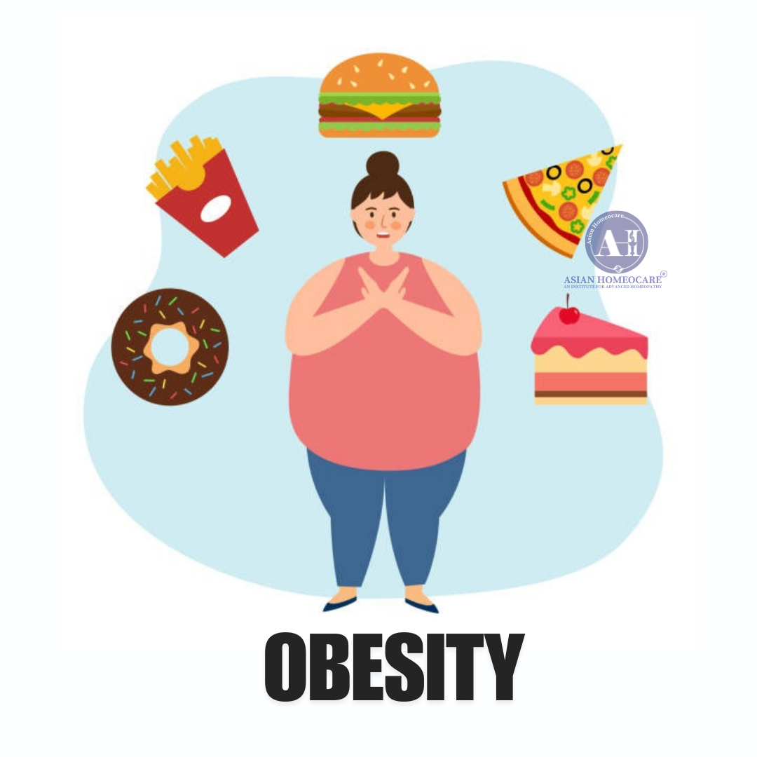


Results
Heart Issues
Obesity
Health Issues
Diseases, like Cancers, inner organs and more..

Slide 8
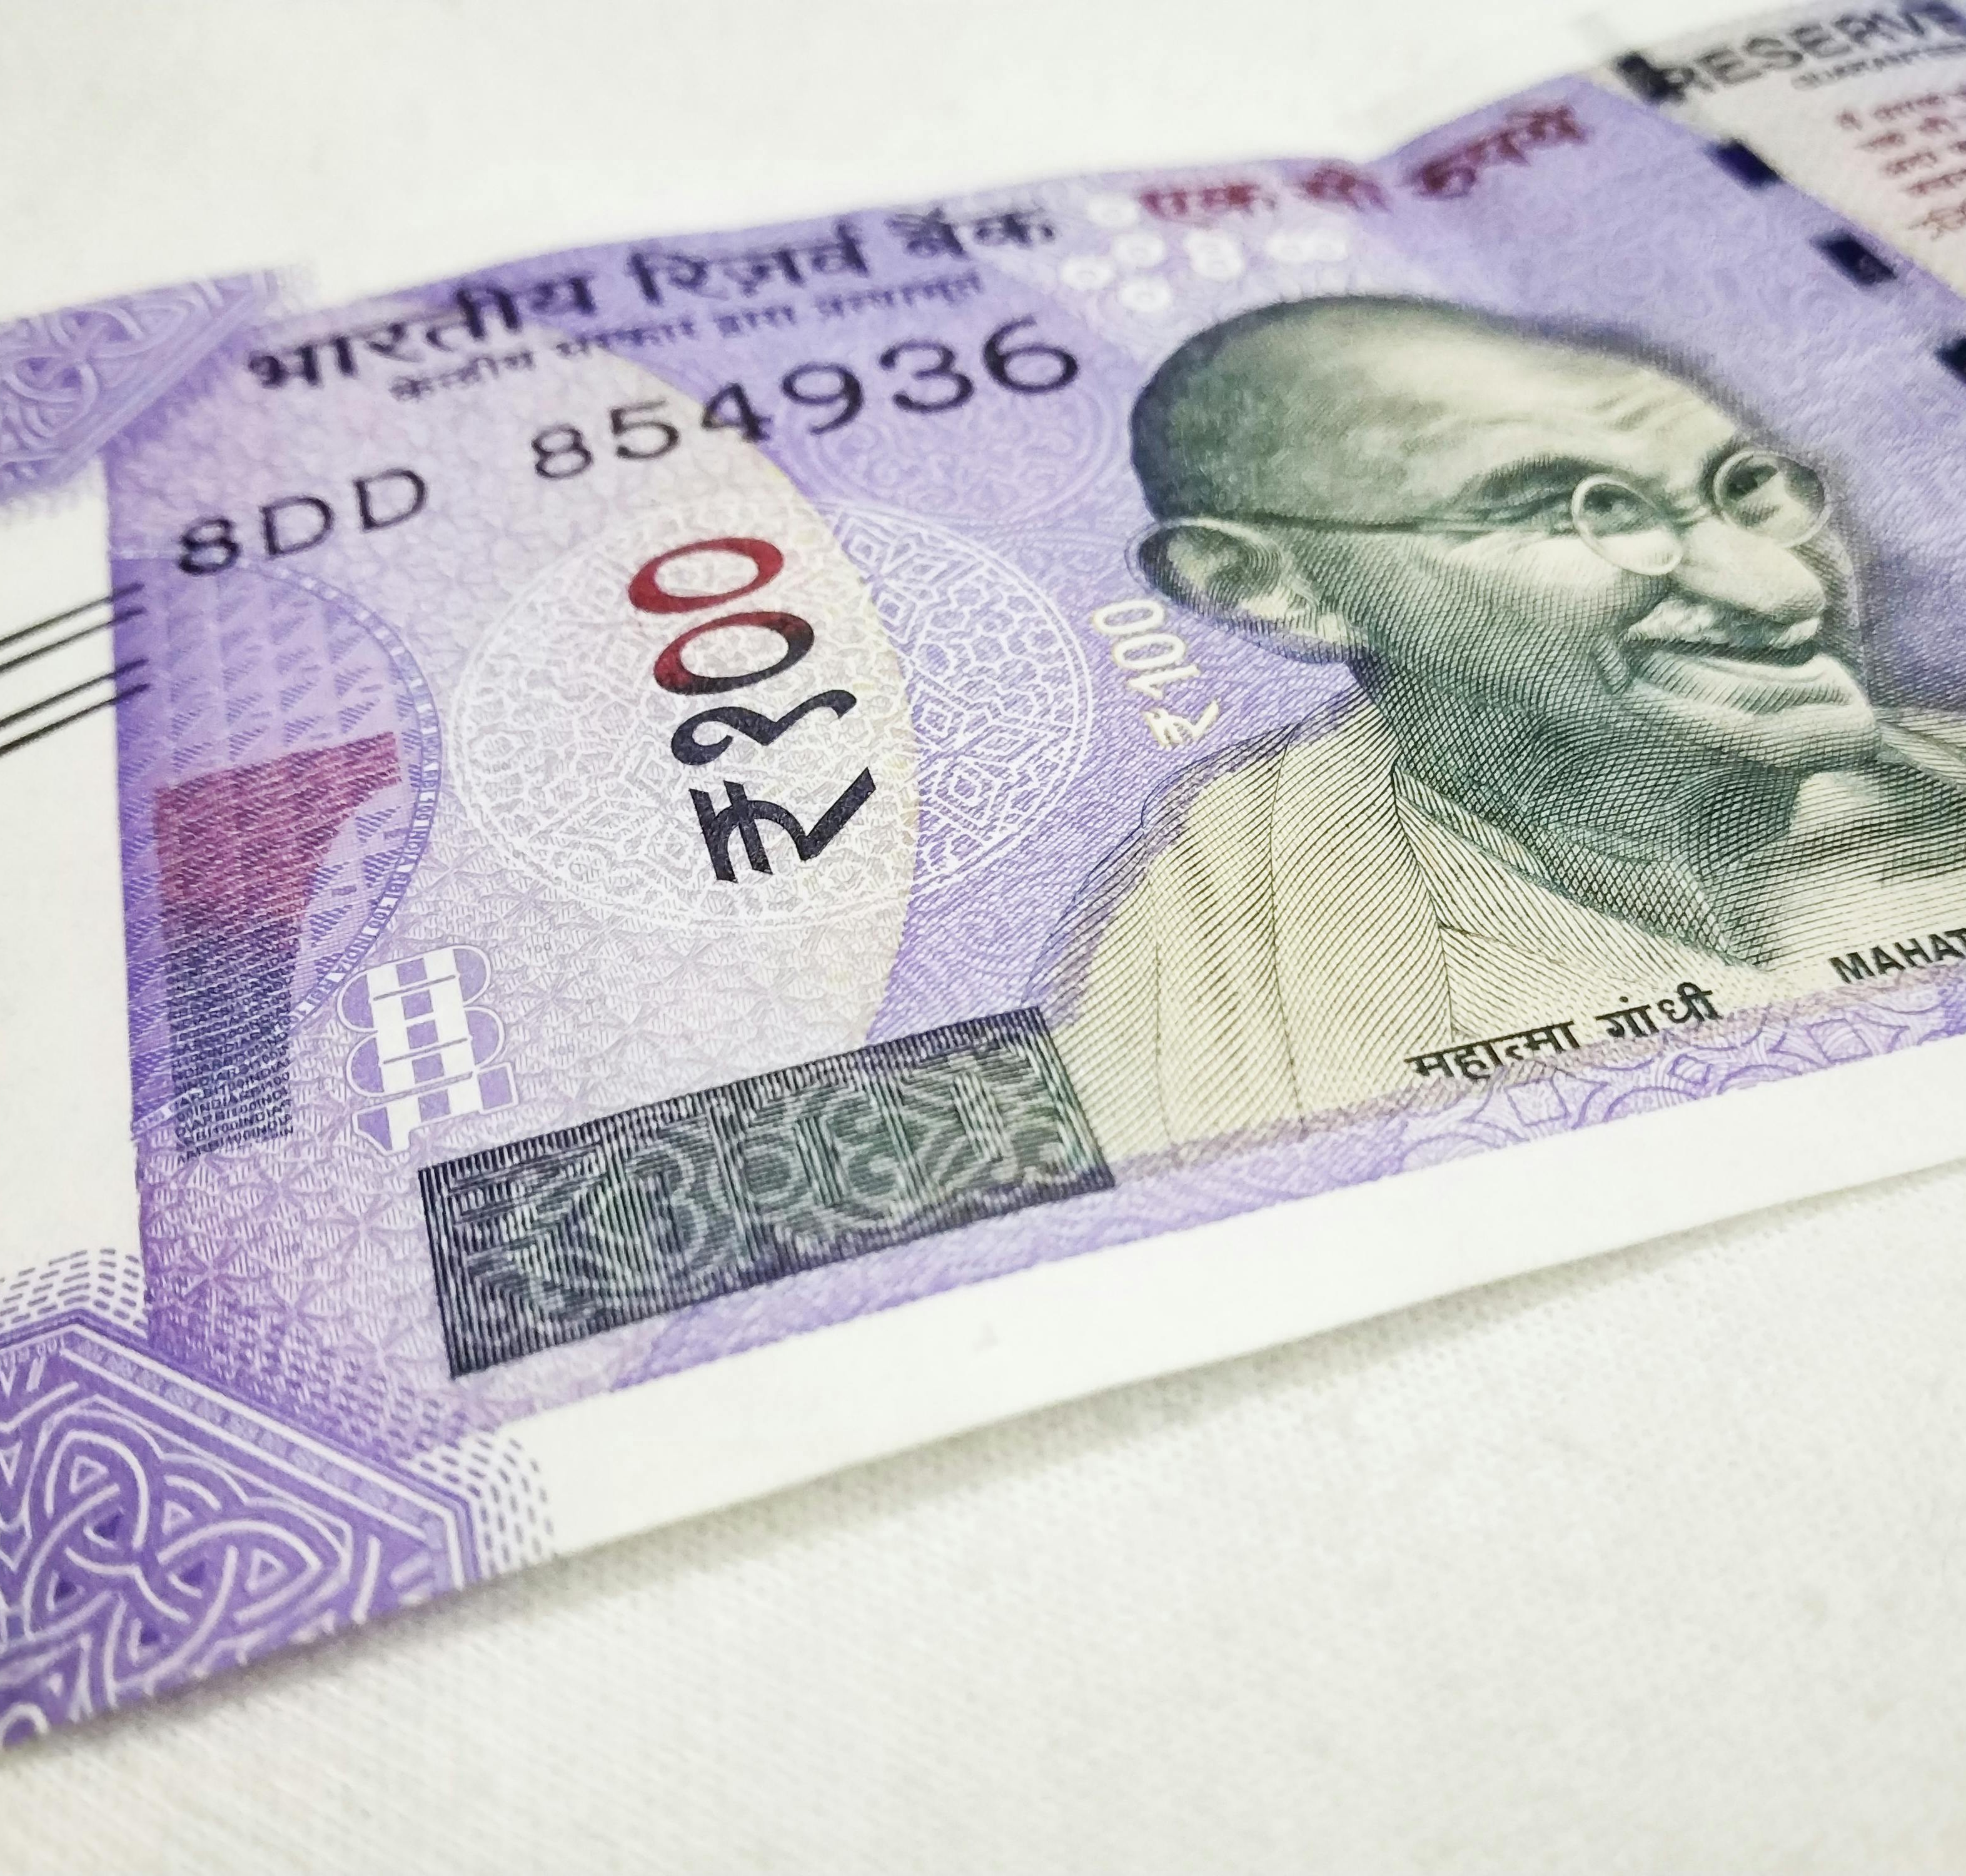
Why ?
Cost Reduction: Companies use cheap synthetic additives to extend shelf life and cut costs.
Misleading Labels: Terms like "natural" and "low-fat" are often deceptive marketing strategies.
Regulatory Loopholes: Weak oversight allows unsafe additives in food.
Competitive Pressure: Companies prioritize taste and appearance over nutrition.

Slide 9

Solution: Awareness
Public Side : Read ingredient labels & avoid harmful additives. Choose fresh, natural, and organic alternatives. Support ethical brands & demand transparency. Spread awareness about misleading food practices. | Org. or Gov. responsibility Stricter FSSAI regulations to ban harmful additives. Mandatory clear labeling & ingredient disclosure. Public awareness campaigns to identify unsafe foods. Frequent product testing & independent monitoring.

Slide 10

Conclusion :
Unhealthy packaged foods are a major public health concern, We together need to improve it.
Stronger enforcement & consumer education are crucial.
By making informed choices, we can demand safer food products.
Say No to Unhealthy Food – Choose Health!
( Every thing in limit! )

Slide 11

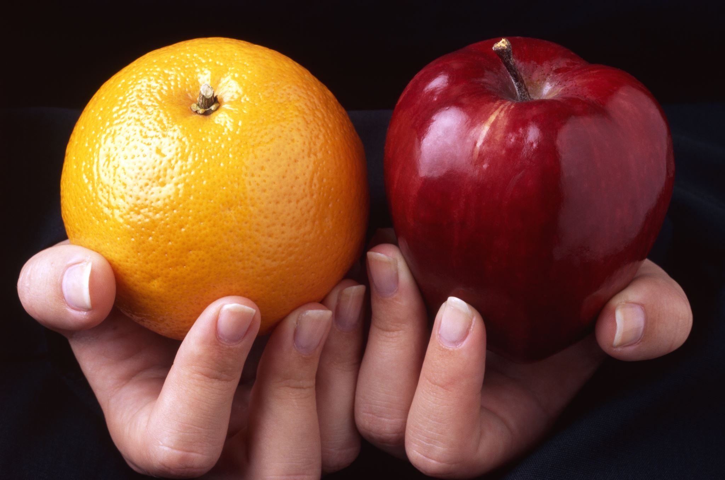
Thank you
From Team
Jatin Reddy
Bhumika Godbole

